Slide 1
Business STAT 550
House Pricing Analysis
Nate Duhl, Alex Kramer, Lisa Scharfenberger, and Matt Monterosso
Notes:
Lisa

Slide 2
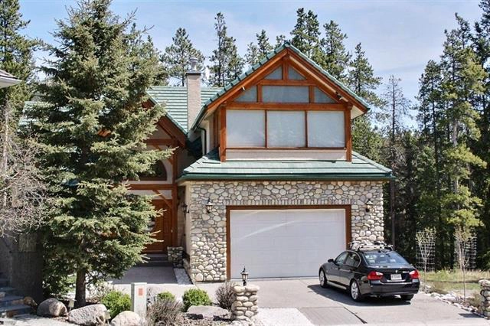
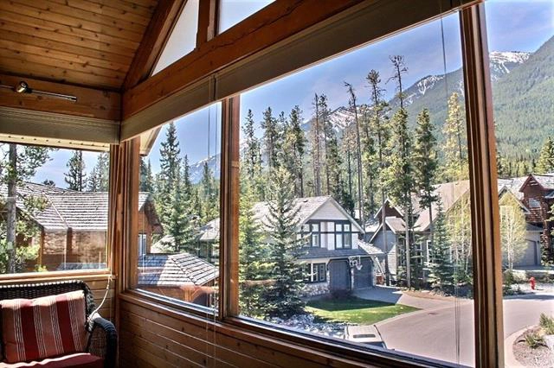
Professor Kleitz recently purchased a new home in beautiful Banff, Canada and now is wondering did she get a good deal?
The Problem?
Notes:
Lisa

Slide 3
Variables
Price : (Y/Dependent Variable)
Selling price of the property ( in $1,000 increments so $330 = $330,000 US dollars)
Beds: (X1)
Number of bedrooms in the house
Baths: (X2)
Number of bathrooms in the house
Square Feet: (X3)
Size of the house in square feet
Miles to Resort: (X4)
Miles from the property to the downtown resort area
Miles to Base: (X5)
Miles from the property to the base of the ski resort’s mountain
Acres: (X6)
Lot size in number of acres
Cars: (X7)
Number of cars that will fit into the garage
Years Old: (X8)
Age of the house, in years, at the time it was listed
DoM: (X9)
Number of days the house was on the market before it sold
Notes:
Lisa

Slide 4
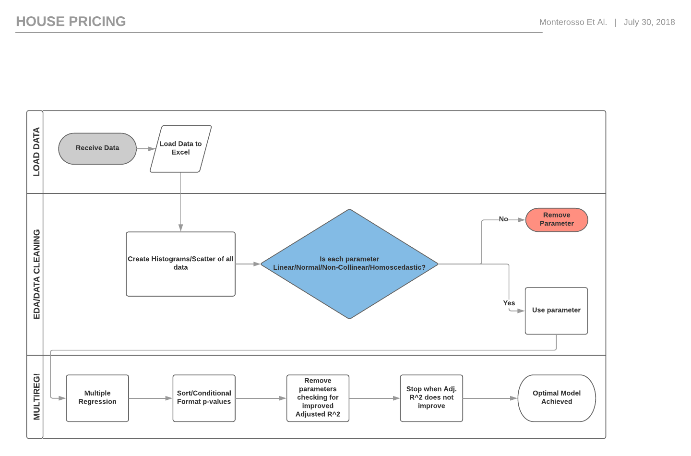
Linear Regression Model Process (Backwards Stepwise Analysis)
Notes:
Nate

Slide 5
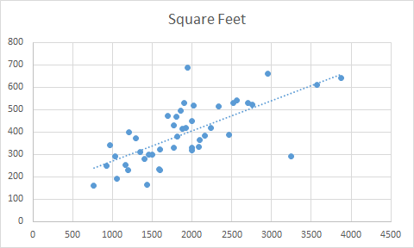
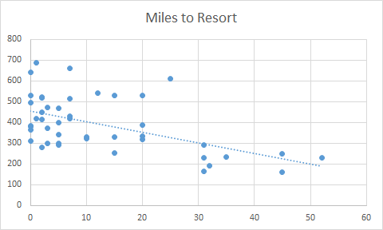
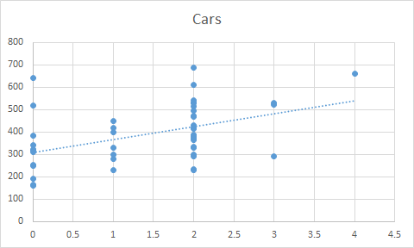
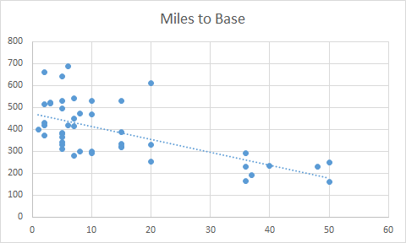
Scatter Plots
Notes:
Matt

Slide 6
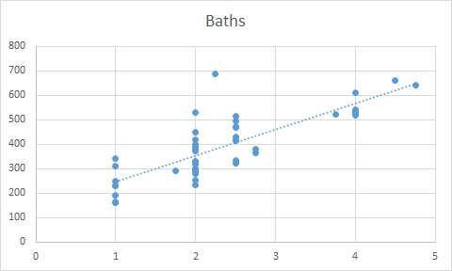
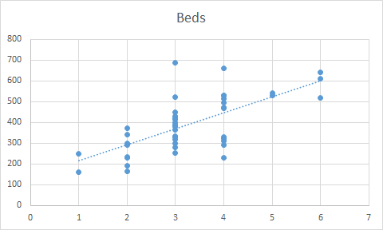
Scatter Plots
Notes:
Nate

Slide 7
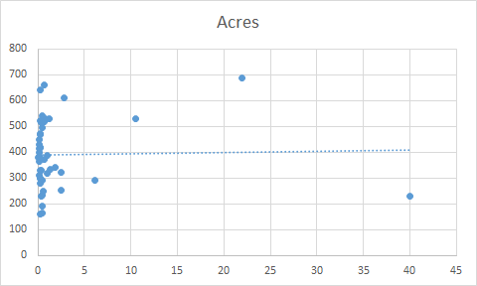
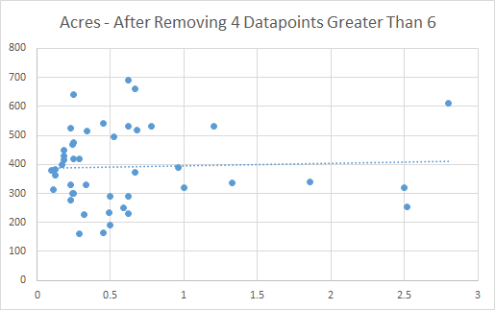
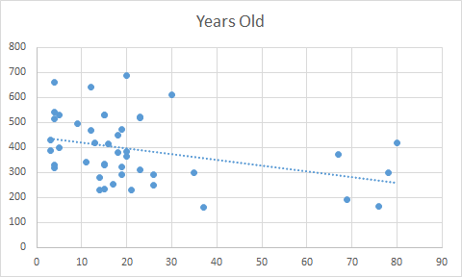
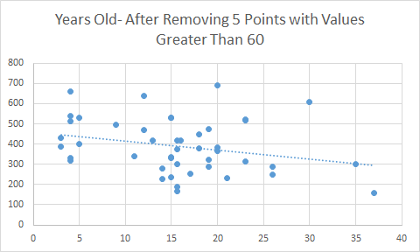
Scatterplots corrected for outliers
Notes:
Nate

Slide 8
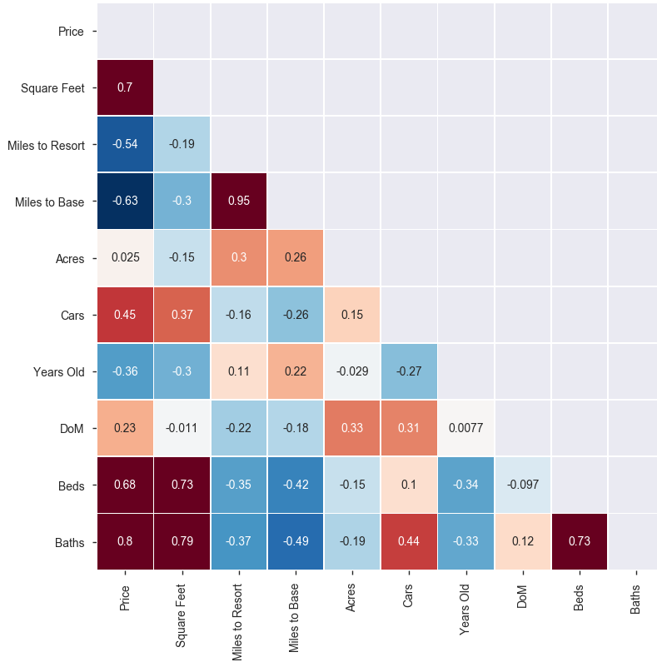
Pearson Correlation ‘Heatmap’
Bad!
Notes:
Matt

Slide 9
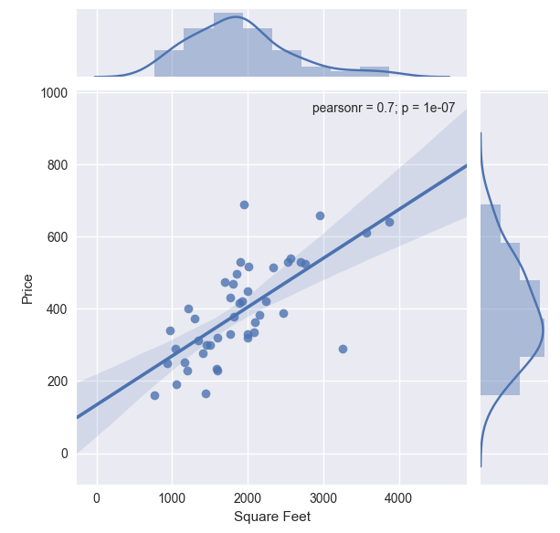
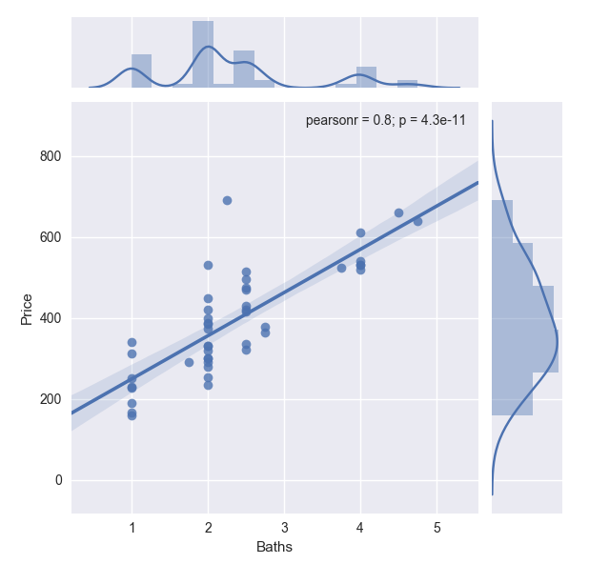
Joint Plots for Regression Variables
Notes:
Matt

Slide 10
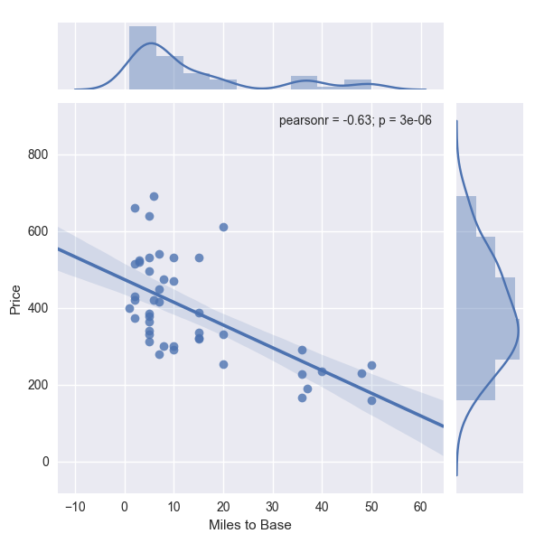
Notes:
Matt

Slide 11
9 Variables
3 Regressions
Best fit model with 3 Variables
Notes:
Alex

Slide 12
Model Significance
Significance F of 2.03E-12
Model Fit
Adjusted R^2 value of ~0.81
Model Assumptions
🗸 Linear
🗸 Normally Distributed
X No Multicollinearity*
X Homoscedasticity**
*Square feet and baths are collinear but the model has a better fit including both variables
**Miles to base is somewhat homoscedastic. Recommend using the model for properties within 20 miles of the base
Notes:
Alex

Slide 13
Significant Variable Interpretation
Square Feet:An increase in 1 square foot will add approximately $36 in value to the home.
Miles to Base: An increase in one mile from the base decreases the home value by ~$2,731
Baths: An additional bathroom adds an approximate value of $69,421 to the home.
Notes:
Alex

Slide 14
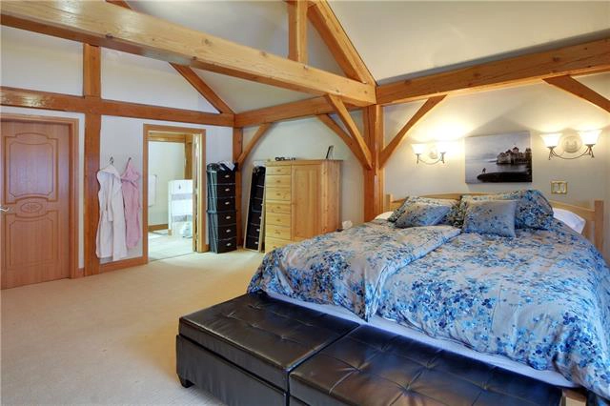
House Value = 189.8+ 36.15 (Square Feet) - 2.73 (Miles to base) + 69.42 (Number of Baths)
Prediction Based on Specifications of Dr. Kleitz New Home: $323,356.68
Beds: 2
Baths: 1
Square Feet: 2000
Miles to Resort: 10
Miles to Base: 3
Acres: 0.45
Cars:1
Years Old: 8
DoM: 123
Regression Model Equation.
Notes:
Alex

Slide 15
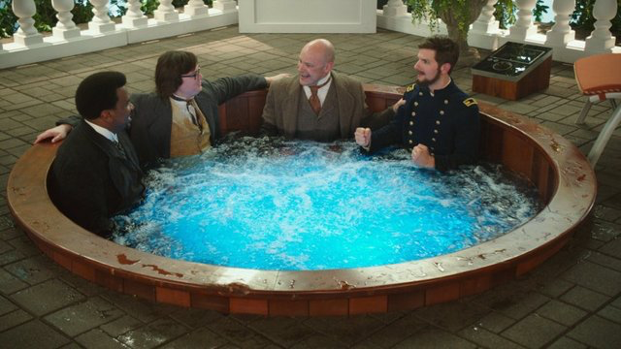
We got a deal (~$23,356)! We were so excited about it that we made an impulsive purchase...
Notes:
Alex

